Slide 1
Python Programming
Eun Woo Kim
Big Data Camp
(May 11th, 2016)
1/11

Slide 2
As a beginner of programming..
V
Code is confusing
Don’t know if I can do programming..
Don’t know what I can do with Python..
V
Reed
2/11

Slide 3
I am here to share with you
“Six things I wish I had known a year ago
about Python Programming”
3/11

Slide 4
(1) Need many packages (or modules)
import
os
-- operating system interface
-- string processing
-- csv file reading/writing
-- natural language processing
package
or
module
import XXX
import YYY
import ZZZ
import statistics
import
re
import
csv
import
nltk
mean
You may have to import many modules.
(
[1,2,3,4,5]
statistics
)
.
Don’t worry about it.
function / method
4/11
Notes:
The statistics module calculates basic statistical properties (the mean, median, variance, etc.) of numeric data
The os module provides dozens of functions for interacting with the operating system
The re module provides regular expression tools for advanced string processing.

Slide 5
(2) Directory matters
import os
os.getcwd()
os.chdir(‘U:\\Big Data Camp’)
os.listdir()
os.mkdir(‘folder1’)
os.rename(‘folder1’, ‘newfolder’)
os.rename(‘test1.txt’, ‘newname.txt’)
-- get current working directory
-- change the current working directory
-- returns a list of sub directories and file in this path
-- make a new directory
-- renaming a directory
-- renaming a file
5/11
Notes:
It's ok if the files aren't in the current working directory, but the path you give it has to reflect that

Slide 6
(3) Reading/writing a file needs a practice
A. Reading a file
open(‘name1.txt’)
list(open(‘name1.txt’))
import csv
with open(‘name1.txt’, ‘r’) as f:
csv_read = csv.reader(f, delimiter=‘\t’)
for a in csv_read:
print(a[0:3])
word1 word2 word3
line1
line2
line3
[‘word1\tword2\tword3’]
[‘line1\n’, ‘line2\n’, ‘line3’]
[‘word1’, ‘word2’, ‘word3’]
[‘line1’, ‘line2’, ‘line3’]
6/11
Notes:
One example code

Slide 7
(3) Reading/writing a file needs a practice
word1 word2 word3
[‘word1\tword2\tword3’]
hello
B. Writing a file
open(‘name1.txt’)
list(open(‘name1.txt’))
with open(‘name1.txt’, ‘w’) as g:
g.write(‘hello’)
7/11
Notes:
One example code
Append: ‘a’

Slide 8
(4) Always write comments
# specify how many tweets I want
totalNumTweet = 10000
def writeResult (scores):
# example scores entry:
# {‘1_U of M’ : {‘innovation’: {2015: 92, 2016: 93},
# ‘donation’: {2015: 85, 2016: 90} } }
Comments help you remember what your code is for.
Comments help you think clearly.
8/11

Slide 9
(5) Googling is ok, actually very common and recommended
Try running your code as you write.
- when you encounter an error,
think about what could have been the problem.
- if you cannot figure out the problem by yourself, google!
Online resources: Python tutorial, Stackoverflow
-There can be multiple answers to one question.
-It is still hard to figure out which answer is the best.
-Start with one answer that seems reasonable and which you can understand the most.
8/11
Notes:
Don’t wait to run your codes until you finish writing all the codes.

Slide 10
(6) It is like learning a foreign language
It takes a long time
You need to learn grammars, vocabularies, sentence structures, etc.
There are many ways of writing codes
Compare your codes with other people’s codes
You have to practice a lot (trial and error)
Talk with other people who use Python or who do programming
Think about why you want to learn Python
If you like it, you learn fast
10/11

Slide 11
What I did after Big Data Camp
(1) Took class: Ling 441 ‘Computational Linguistics’
(2) Tried using Python instead of Excel!
(3) Used Python and API for my research project
11/11

Slide 12
print('T'+'H'+'A'+'N'+'K'+' '+'Y'+'O'+'U'+'!')

Slide 13
Natural Language Processing for Understanding Big Data
Reed Coke

Slide 14
What is Natural Language Processing (NLP)?
Humans interact with each other using spoken, written, or signed natural language.

Slide 15
What is Natural Language Processing (NLP)?
Humans interact with each other using spoken and/or written natural language.
Computers interact with each other (ultimately) using binary.
10101110101000101010101010

Slide 16
What is Natural Language Processing (NLP)?
Humans interact with each other using spoken and/or written natural language.
Computers interact with each other (ultimately) using binary.
NLP is concerned with getting computers to translate from natural language to binary and back.

Slide 17
Outline
Why is NLP hard?
Preparing data
Cleaning and stemming
Tokenizing with NLTK
Examples and tools
Sentiment analysis
Topic modeling
Word embeddings

Slide 18
NLP is hard
Cat, cat, cats

Slide 19
NLP is hard
Cat, cat, cats
catty, cattle, cataract, catacomb

Slide 20
NLP is hard
Cat, cat, cats
catty, cattle, cataract, catacomb
kitten, kitty, persian, tabby

Slide 21
NLP is hard
Cat, cat, cats
catty, cattle, cataract, catacomb
kitten, kitty, persian, tabby
Mittens, Tiger, Garfield, Mr. Whiskers

Slide 22
NLP is hard
Cat, cat, cats
catty, cattle, cataract, catacomb
kitten, kitty, persian, tabby
Mittens, Tiger, Garfield, Mr. Whiskers
gato, chat, katze, 猫
And that’s just cat

Slide 23
Outline
Why is NLP hard?
Preparing data
Cleaning and stemming
Tokenizing with NLTK
Examples and tools
Sentiment analysis
Topic modeling
Word embeddings

Slide 24
Preparing Data – Cleaning
As we can see, real data are very messy.
There are a few common strategies that can help a lot
Simple cleaning:
Removing punctuation
Lowercasing
Stemming:
run/runs/running -> run

Slide 25
Preparing Data - Tokenization
Tokenization is an extremely important aspect of real NLP
It’s often critical to break a document down into sentences
See spot run. Run spot run. -> [‘See spot run’, ‘Run spot run’]

Slide 26
Preparing Data - Tokenization
Tokenization is an extremely important aspect of real NLP
It’s often critical to break a document down into sentences
See spot run. Run spot run. -> [‘See spot run’, ‘Run spot run’]
Dr. Radev got his Ph.D. from Columbia University in N.Y.C.

Slide 27
Preparing Data - Tokenization
Tokenization is an extremely important aspect of real NLP
It’s often critical to break a document down into sentences
See spot run. Run spot run. -> [‘See spot run’, ‘Run spot run’]
Dr. Radev got his Ph.D. from Columbia University in N.Y.C.
It’s almost always critical to break a document down into words
How do you handle contractions like “don’t”?
How do you handle “Ph.D.”? “N.Y.C.”?
This is where the natural language toolkit (NLTK) comes in

Slide 28
Preparing Data - NLTK
NLTK has a wide variety of NLP tools, including a straightforward connection to tools from many other NLP groups such as Stanford
I won’t get into details, but using most of these tools can be reduced to just a few lines of Python with NLTK.
I highly recommend NLTK

Slide 29
Outline
Why is NLP hard?
Preparing data
Cleaning and stemming
Tokenizing with NLTK
Examples and tools
Summarizing a dataset
Sentiment analysis
Topic modeling
Word embeddings

Slide 30
The Data Set

Slide 31
Summary Statistics
NLP is heavily data-driven
Think about how long it takes children to learn language
Depending on the sophistication, you may require hundreds or thousands of documents to be able to use modern NLP tools
As humans, we will need some kind of summary statistics to understand a corpus of this magnitude

Slide 32
Summary Statistics - Example
 | Most |  |  |  | Fewest
Number of Sentences
Number of Words (tokens)
Tokens per Sentence

Slide 33
Summary Statistics - Example
 | Most |  |  |  | Fewest
Number of Tokens
Number of Unique Words (types)
Types per Token

Slide 34
Summary Statistics - Takeaway
Words/sentence can give a reasonable measure of language complexity
Types/token can give a decent measure of vocabulary breadth
These results depend heavily on cleaning and tokenization!

Slide 35
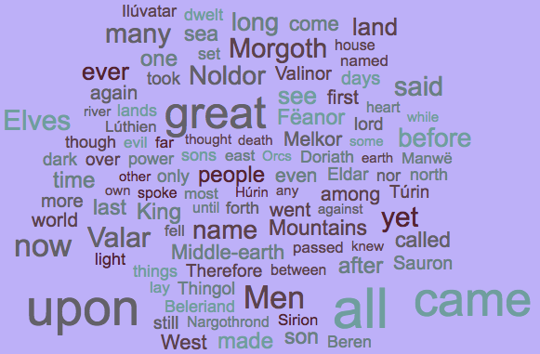
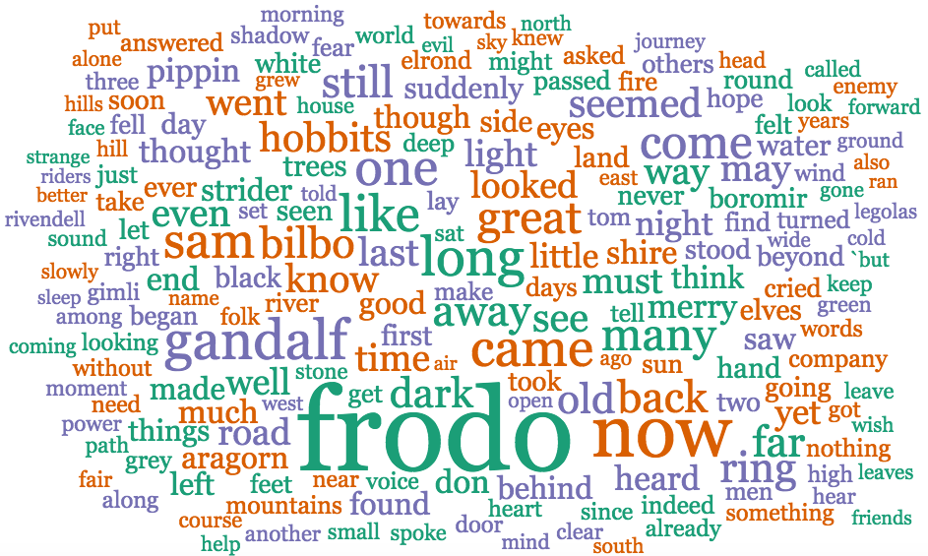
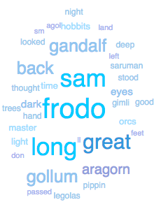
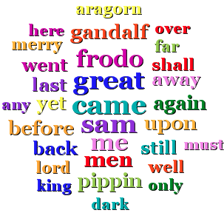
Word It Out
Jason Davies
Word Sift
Google Docs Add-On
Daniel Soper

Slide 36
Named Entity Recognition
NER tools allow you to extract entities present in a text
PERSON, ORGANIZATION, LOCATION (MUC3)
TIME, DATE, MONETARY VALUE, PERCENTAGE (MUC7)

Slide 37
Named Entity Recognition - Example
Sauron - 202 | Bilbo - 527 | Frodo - 995 | Frodo - 464 | Sam - 426
Morgoth - 187 | Thorin - 229 | Sam - 375 | Sam - 408 | Frodo - 346
Beren - 163 | Balin - 67 | Bilbo - 278 | Gimli - 184 | Pippin - 220
Eldar - 142 | Baggins - 59 | Strider - 192 | Legolas - 163 | Faramir - 149
Túrin - 112 | Bard - 50 | Pippin - 164 | Pippin - 154 | Rohan - 86

Slide 38
Named Entity Recognition - Takeaway
I suggest the Stanford tool and NTLK
Important to batch process
Run time went from 10 days to 5 minutes
After you identify all the entities, you may need to combine some
Bilbo, Baggins, Bilbo Baggins
Strider, Aragorn
As always, there will be errors
Shadowfax saw Gandalf (tagged as one entity)

Slide 39
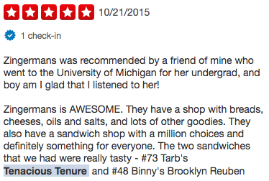
Sentiment Analysis
Sentiment analysis is one of the major applications of current NLP technology.

Slide 40
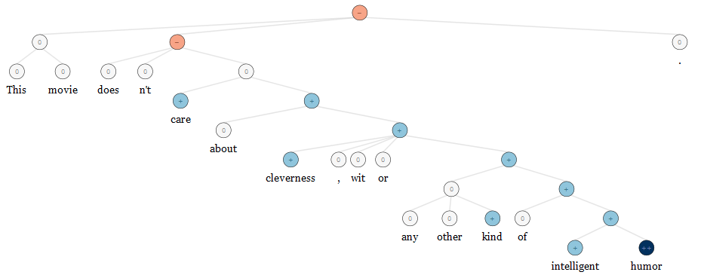
Sentiment Analysis
Sentiment analysis is one of the major applications of current NLP technology.
The field has recently seen strong advances due to Deep Learning.

Slide 41
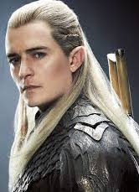
Sentiment Analysis - Example
 | Highest |  |  |  |  |  |  | Lowest
Overall Average Sentiment |  |  | merry | gandalf
Sentiment Standard Deviation |  | gandalf |  |  |  |  |  | merry

Slide 42
Sentiment Analysis - Takeaway
I suggest the new Stanford tool
Be wary of domain differences!
She’s a great athlete and she was not afraid to be aggressive.
This is a terrible restaurant. The wait staff were very aggressive.
Best to have a model that is trained on the same domain

Slide 43
Topic Modelling
Topics models are a great way to explore a corpus
Generative model of document creation
Each document is a weighted combination of topics
Each topic is a weighted combination of words
All words appear in all topics with some (small) probability
To add a word to a document
Pick a topic according to the documents weighted composition
Pick a word according to that topic’s weighted composition
Add the chosen word
LDA is one of several methods for reversing this process to discover the topics that make up a document

Slide 44
Topic Modelling - Example
0.009*upon + 0.008*away + 0.007*came + 0.007*lay
0.007*now0.034*said + 0.017*n't + 0.012*Sam + 0.012*will + 0.011*Frodo
0.011*came + 0.011*'I + 0.008*long + 0.008*great + 0.007*Orcs
0.010*eyes + 0.008*great + 0.008*looked + 0.008*Sam + 0.008*seemed
0.010*great + 0.006*name + 0.005*Morgoth + 0.005*strength + 0.005*power

Slide 45
Topic Modelling - Takeaway
Straightforward, though somewhat tedious, with Gensim
In my opinion, not reliable for classification but good for exploration
Not all topics will be logical for a human
Results strongly depend on number of topics (hyperparameter)

Slide 46
Word Embeddings
Gensim’s Word2Vec is a great tool for generating word embeddings
see
see
Spot
Spot
.
.
.
.
.
.
run
run

Slide 47
Word Embeddings
Gensim’s Word2Vec is a great tool for generating word embeddings
see
see
0.24
Spot
Spot
0.98
.
.
.
.
.
.
run
0.01
run

Slide 48
Word Embeddings – Example uses
One of these things doesn’t belong
[Bilbo, Frodo, Sam, Merry, Pippin] -> Bilbo
Numerical similarity of word pair
(ghost, spirit) -> 0.711402184978
Most similar words
bread -> butter, cream, hot, dried
lembas -> mastery, maker, waybread, Dragons

Slide 49
Word Embeddings - Takeaway
Flexible, useful way to represent word semantics
Lots of pretrained models available for download
Best to train your own, provided you have enough data
You may need quite a bit of data

Slide 50
NLP and You
Modern tools make it very practical to include NLP in any project
NLTK and Gensim are good tools focused on simplicity and easy of use
All the code I wrote for my analysis is available on GitHub, complete with a wiki to help you install support tools
Github name: reedcoke
Feel free to contact me with any questions – reedcoke@umich.edu

